Slide 1
Object Oriented Programming C++

Slide 2
Unit – 1
INTRODUCTION TO C++
Object oriented programming concepts: Class-Object - Abstraction – Encapsulation-Polymorphism-inheritance- Data Hiding, Introduction to C++: Structure of C++ program, Data types, Operators and control statements, Input and output operators, Dynamic initialization, Reference variables, Classes and Objects: Class specification-Member function definition.

Slide 3
Object Oriented Programming (OOP)
Object-Oriented Programming (OOP) is the term used to describe a programming approach based on objects and classes. The object-oriented paradigm allows us to organize software as a collection of objects that consist of both data and behavior.
OOP is all about creating objects that can interact with each other, this makes it easier to develop programs in OOP as we can understand the relationship between them.

Slide 4
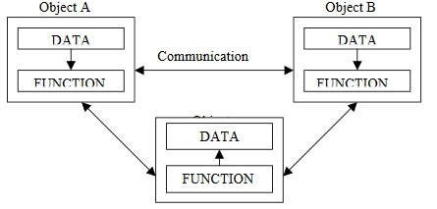
Object Oriented Programming
Emphasis is on data rather than procedure.
Programs are divided into what are known as objects.
Data is hidden and cannot be accessed by external functions.
Objects may communicate with each other through functions.
New data and functions can be easily added whenever necessary.
Follows bottom-up approach in program design

Slide 5
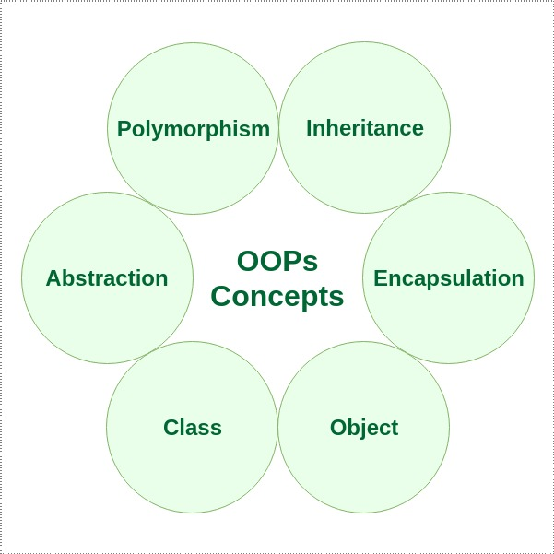
Basic OOP Concepts:
In Object oriented programming we write programs using classes and objects utilizing features of OOPs such as abstraction, encapsulation, inheritance and polymorphism

Slide 6
Objects
Objects are the basic runtime entities in an object oriented system. They may represent a person, a place, a bank account, a table of data or any item that the program has to handle
Objects : Student
Data
Name
DoB
Marks
Methods
Total
Avg
Display
………….

Slide 7
Class
Object contains data, and code to manipulate that data. The entire set of data and code of an object can be made a user- defined data type with the help of a class
Class : Fruit
Object : Mango

Slide 8
Class
A Class is a 3-Compartment Box encapsulating Data and Functions
Class name (or identifier): identifies the class.
Data Members or Variables (or attributes, states, fields): contains the static attributes of the class.
Member Functions (or methods, behaviors, operations): contains the dynamic operations of the class.
Class Name
Data Members (Static Attributes)
Member Functions (Dynamic Operations)

Slide 9
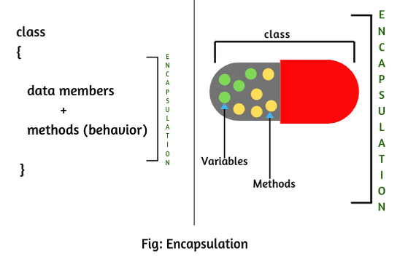
Encapsulation
The wrapping up of data and functions into a single unit is known as encapsulation.
The data is not accessible to the outside world, only those function which are wrapped in the can access it.
These functions provide the interface between the object’s data and the program.
This insulation of the data from direct access by the program is called data hiding or information hiding.

Slide 10
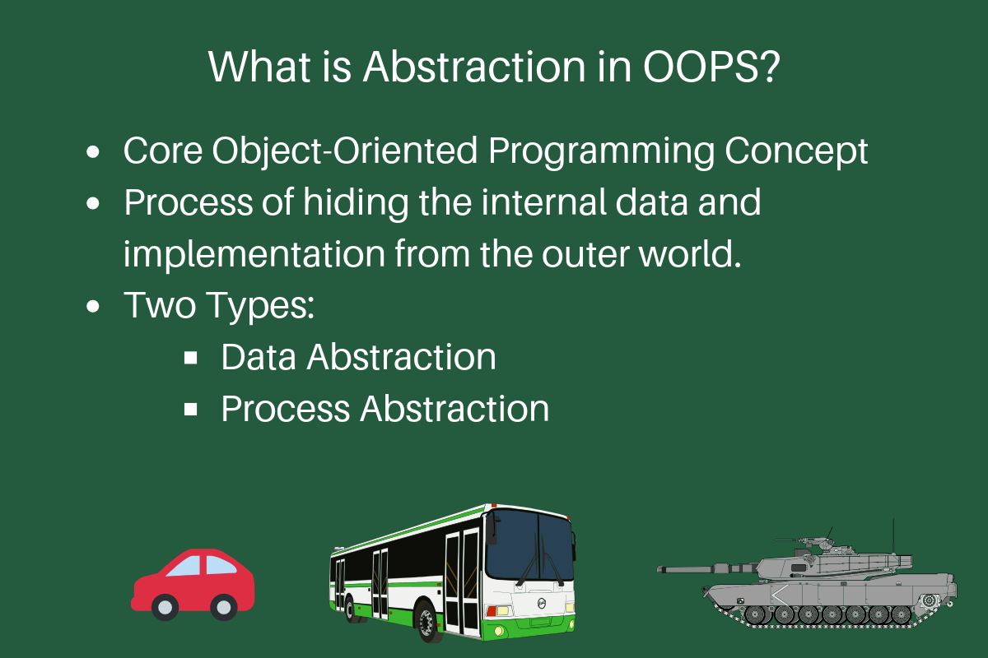
Abstraction
Abstraction refers to the act of representing essential features without including the background details or explanations.
Since classes use the concept of data abstraction, they are known as Abstract Data Types (ADT)

Slide 11
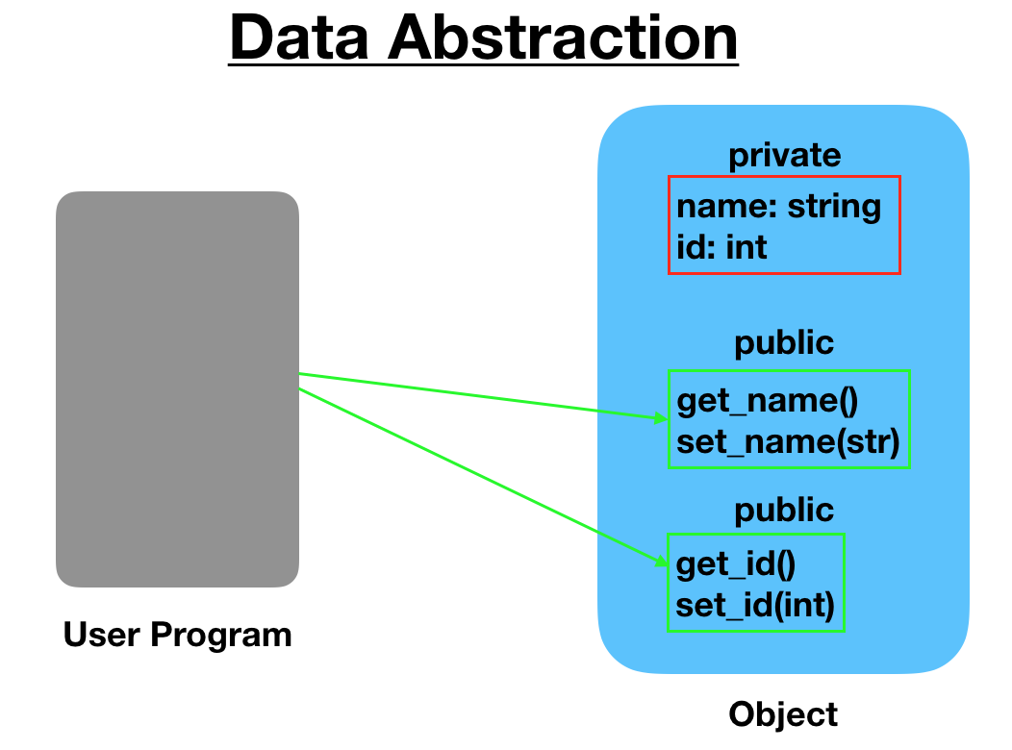

Slide 12
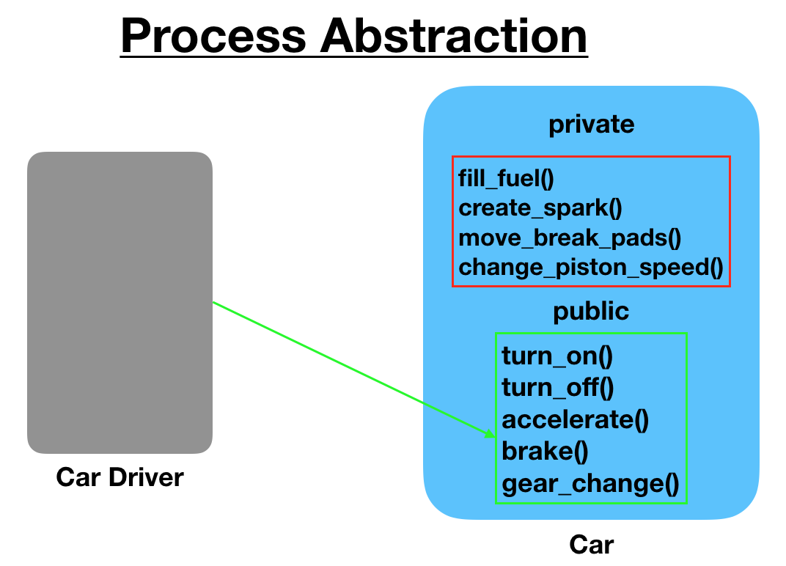

Slide 13
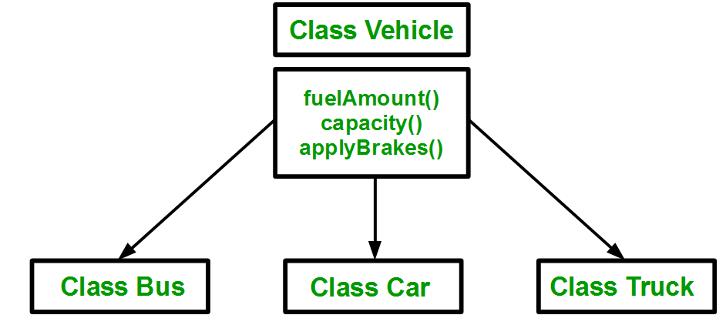
Inheritance
Inheritance is the process by which objects of one class acquire the properties of objects of another class.
In OOP, the concept of inheritance provides the idea of reusability. This means we can add additional features to an existing class without modifying it.

Slide 14
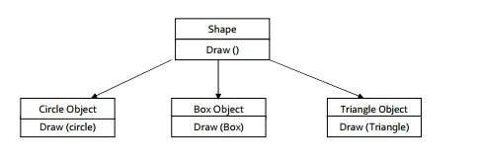
Polymorphism
Polymorphism, (Greek term) - ability to take more than one form.
An operation may exhibits different behaviors in different instances. The behavior depends upon the type of data used in the operation.
For example consider the operation of addition for two numbers; the operation will generate a sum. If the operands are string then the operation would produce a third string by concatenation.
The process of making an operator to exhibit different behavior in different instances is known operator overloading

Slide 15
Benefits of OOP
OOP offers several benefits to both the program designer & the user
Through inheritance, we can eliminate redundant code and extend the use of existing class
We can build programs from the standard working module that communicate with one another, rather than having to start writing code from scratch. This leads to saving of development time & higher productivity.
The principle of data hiding helps the programmer to build & secure programs that cannot be invaded by code in other parts of the program.
It is possible to map objects in the problem domain to those in the program
It is easy to partition the work in a project based on objects
The data-centered design approach enables us to capture more details of a model in implementable form.

Slide 16
Object-oriented systems can be easily upgraded from small to large systems.
Message passing techniques for communication between objects makes the interface descriptions with external systems much simpler.
Software complexity can be easily managed.

Slide 17
Applications of OOP
Real-business systems are often much more complex and contain many more objects with complicated attributes and methods. OOP is useful in these types of applications because it can simplify a complex problem.
The promising areas for application of OOP include:
Real-time systems
Simulation and modeling
Object-oriented databases
Hypertext, hypermedia and expertext
Al and expert systems
Neural networks and parallel programming
Decision support and office automation systems
CIM/CAM/CAD systems

Slide 18
Introduction to C++
C++ is an object-oriented programming language.
C++ was developed by Bjarne Stroustrup at AT&T Bell Laboratories in Murray Hill, New Jersey, USA.
C++ is an extension of C with a major addition of the class construct feature.
Since the class was a major addition to the original C language Stroustrup called the new language 'C with Classes'.
However later in 1983 the name was changed to C++.
The idea of C++ comes from the C increment operator ++ thereby suggesting that C++ is an incremented version of C
C++ is a superset of C.
The three most important facilities that C++ adds on to C are classes, function overloading, and operator overloading.

Slide 19
Simple C++ Program
#include<iostream.h>
int main()
{
cout<<"Hello C++ Programmer";
return 0;
getch();
}

Slide 20
Comments
 // - (Single Line comment)
 /*
*/ -( Multiline comment)
for(j=0;j<10;/* hello */ j++) //Multiline only allowed
{
}

Slide 21
Structure of C++ program
HEADERS
CLASS DECLARATION
MEMBER FUNCTION DEFINITIONS
MAIN FUNCTION

Slide 22
Input operators
cin >> variable-name;
Meaning: read the value of the variable called <variable-name> from the user
The operator >> is known as extraction or get from operator.
It extracts the value from the keyboard and assigns it to the variable on its right
Example:
cin >> a;
cin >> b >> c;
cin >> x;
cin >> my-character;

Slide 23
Output operators
cout << variable-name;
Meaning: print the value of variable <variable-name> to the user
<< : Is called the insertion or put to operator.
It inserts the contents to the variable on its right to the object on its left.
cout << “any message “;
Meaning: print the message within quotes to the user
cout << endl; Meaning: print a new line
Example:
cout << a;
cout << b << c;
cout << “This is my character: “ << my-character << “ end ” << endl;

Slide 24
C++ iostream File
#include <iostream>
This directive causes the preprocessor to add the contents of the iostream file to the program.
It contains declarations for the identifier cout and the operator <<.
The header file iostream should be included at the beginning of all programs that use input/output statements.
The header files with .h extension are ”old style” files which should be used with old compilers. <iostream.h>

Slide 25
Return type of main()
In C++ main() returns an integer type value to the operating system.
Therefore every main() in C++ should end with a return 0; statement otherwise a warning or an error might occur.
Since main() returns an integer type value, return type for main() is explicitly specified as int.
Note that the default return type for all functions in C++ is int.

Slide 26
Difference b/w C and C++
C Language | C++ Language
Procedural Programming Language | Object Oriented Programming Language
Headerfile : #include<stdio.h> | #include<iostream.h>
“\n” is used to go to the next line | we can use endl statement
Local variables declared only the start of a C program | It can be declared anywhere in a program, before they are used
Return type for a function is optional | Return type must be specified
Do not permit data Hiding | They permit data hiding
Bydefault structure members are public | class members are private
We can call a main() function within a program | This is not allowed

Slide 27
Tokens(1/4)
The smallest individual units in a program are known as tokens.
C++ has the following tokens:
Keywords
Identifiers
Constants
Strings
operators

Slide 28
Tokens(2/4)
asm | double | new | switch
auto | else | operator | template
break | enum | private | this
case | extern | protected | throw
catch | float | public | try
char | for | register | typedef
class | friend | return | union
const | goto | short | unsigned
continue | if | signed | virtual
default | inline | sizeof | void
delete | int | static | volatile
do | long | struct | while
bool | export | reinterpret_cast | typename
const_cast | false | static_cast | using
dynamic_cast | mutable | true | wchar_t
explicit | namespace | typeid

Slide 29
Tokens(3/4)
Identifiers and constants:
Identifiers refer to the names of variables, functions, arrays, classes created by the programmer.
Rules for identifiers
Only alphabetic characters, digits and underscores are permitted.
The name cannot start with digit
Uppercase and lowercase letters are distinct.
Keywords cannot be used.

Slide 30
Tokens(4/4)
Constants:
Constants refer to fixed values that don‟t change during the execution of a program.
C++ supports several kinds of literal constants
They include integers, characters, floating point numbers and strings.
Examples:
123
12.34
037
0x2 “C++”
„a‟
//decimal constant
//floating point constant
//octal constant
//hexadecimal constant
//string constant
// character constant
C++ also recognizes all the backslash character constants available in C.

Slide 31
Basic data types(1/3)
C++ data types
User defined data types
Structure
Union
Class
Enumerated type
Built-in type
Integral type
int
char
Floating type
float
double
void
Derived type
Array
Function
Pointer

Slide 32
Data Types(2/3)
ANSI C++ committee has added two more data types, bool and wchar_t.
Bool data type:
The variable of type bool hold a boolean value, true or false.
The bool type variables can be declared as:
bool b1; b1=true;
bool b2 = false;
cout << “b1 = “ << b1 << endl << “b2 = ”<< b2;
Will display the following output:
b1 = 1
b2 = 0
The wchar_t data type:
The character type wchar_t has been defined to hold 16-bit wide characters.

Slide 33
Data Types(3/3)
Void type
The type void was introduced in ANSI C.
Two uses of void are:
To specify the return type of a function when it is not returning any value, and
To indicate an empty argument list to a function.

Slide 34
Operators in C++(1/4)
All C operators are valid in C++.
C++ introduces some new operators which are as follows
<<
>>
::
::*
->*
.* delete endl new setw
insertion operator extraction operator
scope resolution operator
pointer to member declarator pointer-to-member operator pointer to member operator memory release operator
line feed operator
memory allocation operator field width operator

Slide 35
Operators (2/4)
Scope resolution operator( :: )
This operator allows to access the global version of a variable within the inner block.
This operator is used as:
:: variable-name
#include<iostream>
Using namespace std;
int x = 11; // this x is global int main()
{
int x = 22;
cout << "In main: x = " << x << endl;
{
int x = 33;
cout << "In block inside main: x = " << x << endl;
}
// access to the global x
cout << "In main: ::x = " << ::x << endl;
return 0;
}

Slide 36
Operators (3/4)
Memory management operators
New and delete operators
An object can be created by using new, and destroyed by using delete
A data object created inside a block with new, will remain in existence until it is explicitly destroyed by using delete .
The new operator can be used to create objects of any type. It takes the following general form:
Pointer-variable = new data-type;
Pointer variable is a pointer of type data-type.
The new operator allocates sufficient memory to hold a data object of type data-type and returns address of that object.
Examples:
int *p = new int; float q = new float;
Initialization using new operator:
Pointer-variable = new data-type(value);

Slide 37
Operators (4/4)
delete operator:
When data object is no longer needed, it is destroyed to release the memory space for reuse as :
delete pointer-variable;
The pointer-variable is the pointer that points to a data object created with new.
Examples:
delete p;
delete q;

Slide 38
Manipulators (1/2)
Manipulators:
Operators that are used to format the data display.
Commonly used manipulators are endl and setw.
The endl manipulator, when used in an output statement, causes a linefeed to be inserted.
It has same effect as using the newline character “\n”.
The setw manipulator specifies the field width for the output and print the result in right justified form.

Slide 39
Manipulators (2/2)
Example:
Use of endl | Use of setw
int main() { int m=1234,n=56,p=789; cout<<“m = ”<< m << endl << “n = ” << n << endl << “p = ” << p << endl return 0; } output: m =234 n = 56 p = 789 | int main() { int m=1234,n=56,p=789; cout<<“m = ”<<setw(5)<< m << endl << “n = ” << setw(5)<<n << endl << “p = ” <<setw(5)<< p << endl // setw(5) specifies a field width 5 for printing the values return 0; } output: m = 234 n = 56 p = 789

Slide 40
Control structures(1/5)
Control structures
Branching structure
If-else statement
Switch statement
Loop structure
for loop
while loop
do-while loop

Slide 41
Control structures(2/5)
If-else statement Flow chart
Syntax:
if (condition)
{
conditi on
if block statements;
False
}
else
{
else block statements;
}
True
If block statements
else block
statements

Slide 42
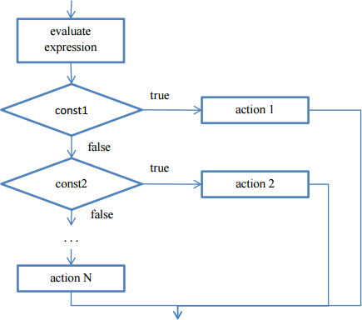
Control structures(3/5)
Switch statement:
Syntax:
switch (expression)
{
case const1: action1; break;
case const2: action2; break;
case const3: action3; break;
...
default:
actionN;
}

Slide 43
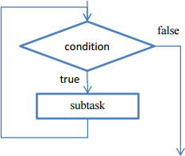
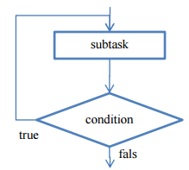
Control structures(4/5)
Iterative constructs
– Iterative construct means that some statements multiple times until some condition is met.
while statements Syntax:
while (condition)
{ subtask;
}
will be executed
do-while statement
Syntax:
do
{
Subtask;
} while (condition);

Slide 44
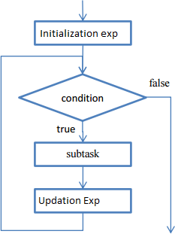
Control structures(2/5)
for statement Syntax:
for (initilization_expression; test_expression; updation_expression)
{
subtask;
}

Slide 45
Dynamic Initialization
In C++, a variable can be initialized at runtime using expressions at the place of declarations.
float area = 3.14*rad*rad
Thus both declaration and initialization of a variable can be done by simultaneously at the place where the variable used for the first time.

Slide 46
Reference variable
A reference variable provides an alias (alternative name) for a previously declared variable
data_type &reference_name=variable_name
Ex: float total = 100;
float & sum= total;
A reference variable must be initialized at the time of declaration. This establish correspondence between the reference and the data object which it names.

Slide 47
Classes and Objects
object - An object is an instance of a class which combines both data and functions together.
Method - an action performed by an object (a verb)
Attribute - description of objects in a class
class - a category of similar objects
- does not hold any values of the object’s attributes
By default all members declared inside a class are private to that class

Slide 48
Classes in C++
A class definition begins with the keyword class.
The body of the class is contained within a set of braces, { } ; (notice the semi-colon).
class class_name
{
….
….
….
};
Any valid identifier
Class body (data member + methods)

Slide 49
Class Example
This class example shows how we can encapsulate (gather) a circle information into one package (unit or class)
No need for others classes to access and retrieve its value directly. The class methods are responsible for that only.
class Circle
{
private:
double radius;
public:
void setRadius(double r);
double getDiameter();
double getArea();
double getCircumference();
};
They are accessible from outside
the class, and they can access the
member (radius)

Slide 50
class Circle
{
private:
double radius;
public:
Circle() { radius = 0.0;}
Circle(int r);
void setRadius(double r){radius = r;}
double getDiameter(){ return radius *2;}
double getArea();
double getCircumference();
};
Circle::Circle(int r)
{
radius = r;
}
double Circle::getArea()
{
return radius * radius * (22.0/7);
}
double Circle:: getCircumference()
{
return 2 * radius * (22.0/7);
}
Scope resolution operator
::
Defined outside class

Slide 51
REVIEW
What is an Object and what is a Class? What is the difference between them?
What is an Attribute?
What is an Operation?
What is inheritance?
What is polymorphism?
Describe the Basic concepts of OOPS?
State the use of #include directive in C++?

Slide 52
Exercises
Write a program in C++ to find the area of circle using input value ?
Write a program in C++ to Arithmetic operations of two integer numbers ?
Write a program in C++ to print the upper case letters to lower case ?
Write a program in C++ to show of a numeric value of a variable using hex, oct, and dec manipulator functions. ?
Write a program in C++ to check whether the given character upper, lower , numbr or not ?
Write a program in C++ to find biggest of three given numbers ?
Write a program in C++ to display the name of the day in a week .here given input range is 1 to 7. ?
Write a program in C++ to display the even or odd numbers between 1 to 100 using while loop ?
Write a program in C++ to print a word form of given number between 0 to 9 using Switch ?
Write a program in C++ to find the smallest of 10 numbers ?

Slide 53
Thank You!

